Slide 1
Introduction
C-Jay Consulting has reviewed and appraised the survey questions asked to employees, by the Higher Health Company, to determine the quality and clarity of the survey and its intended results.
We are please to offer our findings and perspective as to why C-JAY Consulting believes that Higher Health would benefit from implementing a new HRIS system to improve the overall organization and the employee morale and quality of work.
We have provided an analysis of the data to better provide the Higher Health Company an enhanced understanding of the flaws and advantages of the survey with a focus on its response rate, data errors, range of responses, variance and the averages of the survey within the Training and Development section.

Slide 2
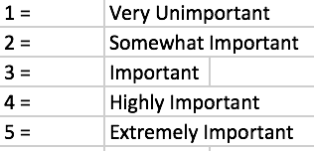
Review of Survey Questions
Survey was divided into multiple sections
Employee Demographics
Leave Management
Benefits
Wealth Management
Training & Development
Performance Management
HR Personnel Questions
HR Management Questions – for HR personnel only
C-JAY Consulting focused on Training & Development portion of survey (see Appendix A)
Ordinal Likert-scale model presented
Based on opinion of employees, wide range of interpretation of questions and answers (see Appendix B)

Slide 3
Review of Data
Survey provided by Higher Health without consultation or review
Questions were minimal and open for wide interpretation
Lack of validity can be found based on response rate, data errors, range of responses, variance and the averages
High range of responses provided by employees
Answers were broadly dispersed between high importance and low importance
Does not provide a clear answer that Higher Health was looking for to make changes in the HRIS system (see Appendix C)

Slide 4
HRIS Needs Analysis
Where are we now?
Where are we going?
How are we going to get there?
C-Jay Consulting defined the Higher Health HRIS needs:
Windows based
Integrated Payroll
Training Management
Turnover Reports
ESS
Salary Grades
Job and Pay History
Attendance and Accrual tracking
Report Writing
Ease of use

Slide 5
Build vs. Buy
Since Higher Health is not going to use this HRIS as a competitive advantage, and the requested needs are not unusual within HR field, C-JAY Consulting decided that the fastest, cheapest and most practical way of using it will be BUY AN OFF-THE-SHELF SYSTEM, which allows getting a system in place at a low cost and is faster than building.
Advantages:
Implementation Speed
Lower Total Cost
Includes best practices from multiple clients
Vendor R&D/Technology and Support
Internal staff will be used less during the implementation because the vendor provides much of the needed resources in its cost

Slide 6
HRIS Vendors
C-JAY Consulting Group decided on the innovative system of Paylocity because it can modify the needs of Higher Health now and for the future.
Benefits Administration, Human Capital Management, Time and Labor, Payroll and Talent Management are the applications that Paylocity covers.
Paylocity has developed a cloud-based solution that enables an organization to administer workforces more efficiently.
What makes Paylocity unique is that every employee makes their portal customizable to their needs and wants
Paylocity offers on-demand courses, interactive training and webinars to help the employee gain knowledge and provide hands-on instruction from experts.

Slide 7
Customer Reviews on Paylocity by Trust Radius
Pros
Cons
Jamie Powers (2016) states “I think Paylocty is a great HRIS system that offers all types of trainings for their clients’ needs at no additional costs.”
Robert Nottingham (2016) also states his strong attraction to the system because it has full HRIS capabilities and the benefits of electronic signatures, custom fields and data management are always a plus.
Bonny O’Neil (2015) articulates that her main issue with Paylocity is the lack of customer service. “The wait time to get an answer in the Customer Service department is absurd.”
Harleen Mangat (2014) states “The ability for managers to enter changes for their employees, i.e. salary, department, job title, etc. and have it routed electronically to the appropriate people for approval.”

Slide 8
Implementing HRIS Software
Implementing an HRIS software can be a difficult transition for the organization as whole.
It is up to management to allow the transition to be smooth and effortless for everyone involved.
C-JAY Consulting Group agrees that Lewin’s Change Model will provide the organization an effortless transition.

Slide 9
Lewin’s Change Model
The steps within Lewin’s Change Model are referred to as unfreeze, change and refreeze.
According to Levasseur (2001), “The first step in the process of changing behavior is to unfreeze the existing situation. Only then can change, or movement, occur. Finally, to make the new behaviors stick, a third, refreezing step is necessary.”
Lewin’s Change Model is a revolutionary step process that is used worldwide that provides organizations with influential and fundamental tools.
Notes:
The change model by Lewins has been one of the most influential theories to be used to date. The primary purpose of this model is that it requires prior learning to be discarded and replaced.

Slide 10
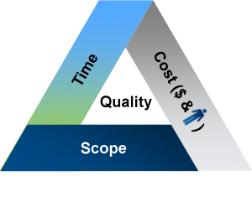
Project Plan
Data Migration (In Progress)
Training on Paylocity
Two-Stage Pilot Conversion
HR Team
Management at Flagship locations.
Company-wide Rollout
Quality Control and Cleanup
Retraining and Enrichment
C-JAY recommends to perform this with all staff biennially to ensure maximum utilization of the system.

Slide 11
Project Team
Board of
Directors
Representation
C-JAY
Consulting
IT
HR
Division
Representation

Slide 12
Team Responsibilities
Board
Goal Setting
Dispute Settlement
C-JAY
Management
Consensus Building
Teams
Decision Making
Design
Details

Slide 13
References
Levasseur, R. E. (2001). People skills: Change management tools - lewin's change model. Interfaces, 31(4), 71-73. Retrieved from http://search.proquest.com.ezproxylocal.library.nova.edu/docview/217124358?accountid=6579
Paylocity Web Pay Reviews & Ratings. (2015, January). Retrieved February 19, 2017, from https://www.trustradius.com/products/paylocity/reviews

Slide 14
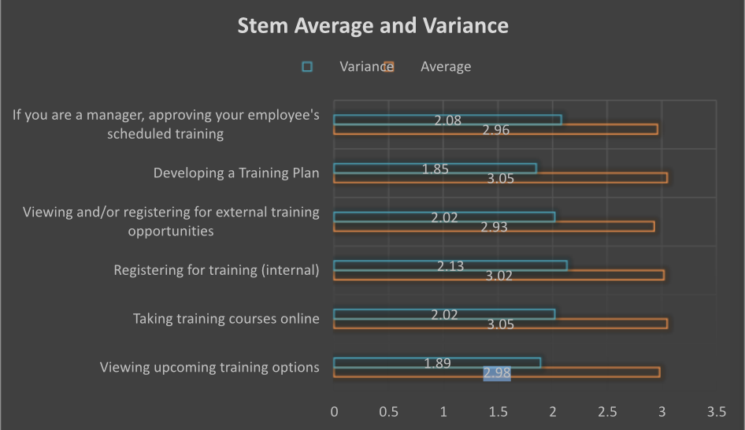
Appendix A

Slide 15
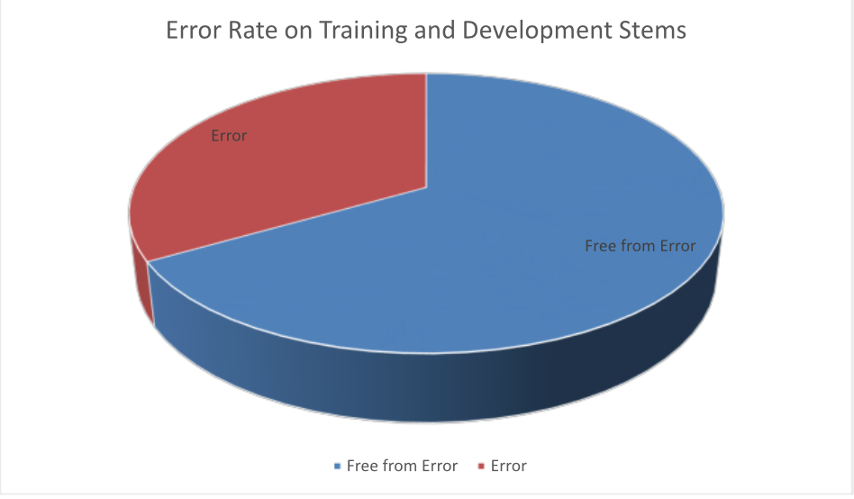
Appendix B

Slide 16
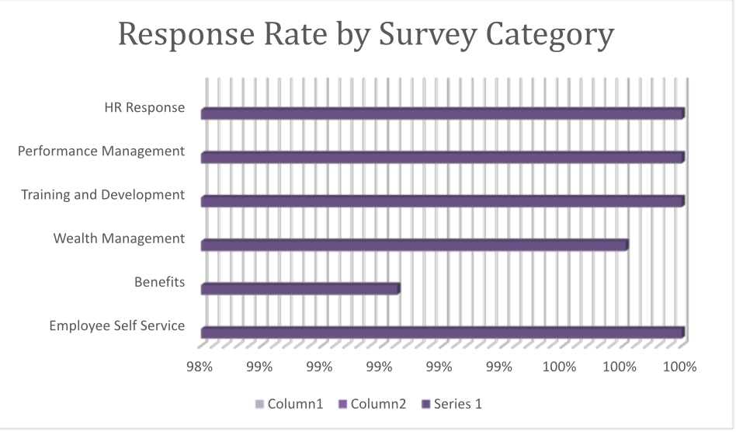
Appendix C

